Slide 1
Signals + Filtering

Slide 2
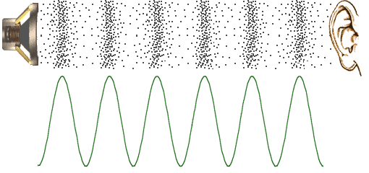
What is sound?
Sound and music contain pressure waves that propagate in air.

Slide 3
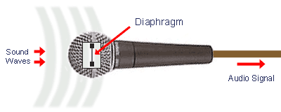
Translation from Sound to Voltages
Microphones are able to capture these waves, and convert them to electrical energy.

Slide 4
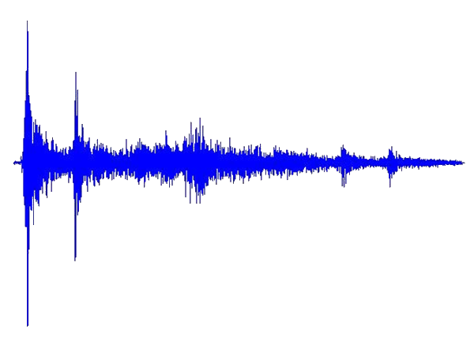
What Does an Electric Signal Look Like?
Fluctuations in voltages describe the characteristics of sound waves:
Loudness (Amplitude)
Timber (Frequency)

Slide 5
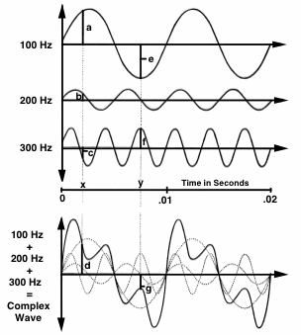
Decomposition of Signals
Signals (and sounds) are uniquely and simultaneously constructed of many periodic frequencies.

Slide 6
Intro to Filtering
Using Electronic Filters, we can modify the properties of sound:
E.g., An equalizer breaks down sounds into several frequency bands, and each band can be independently modified – for example, we can increase the bass of a song by amplifying its lower frequencies.

Slide 7
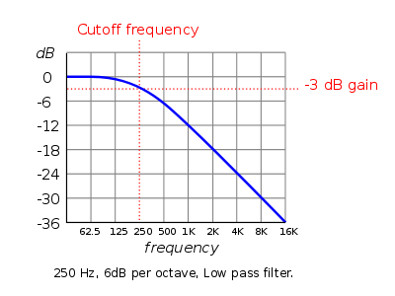
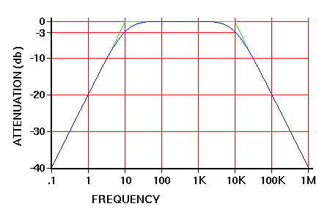
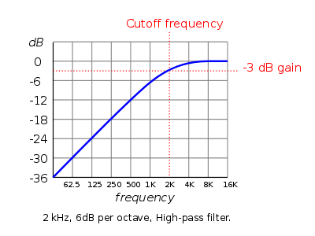
More Filtering
We can also use filters to solely capture some frequency bands:
Low Pass Filter (LPF) – Lets lower frequency signals
through, removes higher frequency signals.
Band Pass Filter (BPF) – Lets frequencies within a
certain range through, removes all other frequencies.
High Pass Filter (HPF) – Lets only higher frequency
signals through, removes lower frequency signals.

Slide 8
Prism Project
The course project consists of 3 filters:
Low Band Pass Filter
Captures: Bass Drums, Low Frequency Hums, Heavy Bass Tracks, etc.
Mid Band Pass Filter
Captures: Vocals, Most Instruments and Sound Effects, etc.
High Band Pass Filter
Captures: Hi-hats, Snare Drums, High Frequency String Instruments, etc.

Slide 9
More on Course Project
If the output from a filter exceeds a certain threshold amount, lights react by flashing.
Low Band Pass Filter
LED 1
Mid Band Pass Filter
Microphone
LED2
High Band Pass Filter
LED3

Slide 10
More on Course Project
A microcontroller (Arduino) receives signals from each of the filters and controls how to make the lights flash and react.
Low Band Pass Filter
Microcontroller
LED 1
Mid Band Pass Filter
Microphone
LED2
High Band Pass Filter
LED3

